Slide 1
UCSD
Screen Sequence Diagram
Fall 2018

Slide 2
UCSD Sample Screens
Project Manager: Xu Chen
Software Architect: Shaoyuan Xu, Shih-Hann Chan
Business Analyst: Hao-Tzu Deng
Senior System Analyst: Cong Li
Quality Assurance Lead: Liu Liu
Algorithm Specialist: Jingsong Chen
Software Development Lead: Jiarong Liu, Yuhang Jiang
UI Specialist: Lu Yu
Database Specialist: Yunshu Gao

Slide 3
Contents
Sample Screen #1: Home screen
Sample Screen #2: Login screen
Sample Screen #3: Event page
Sample Screen #4: Job page
Sample Screen #5: Sign up page
Sample Screen #6: Profile Page
Sample Screen #7:
Sample Screen #8:
Sample Screen #9:

Slide 4
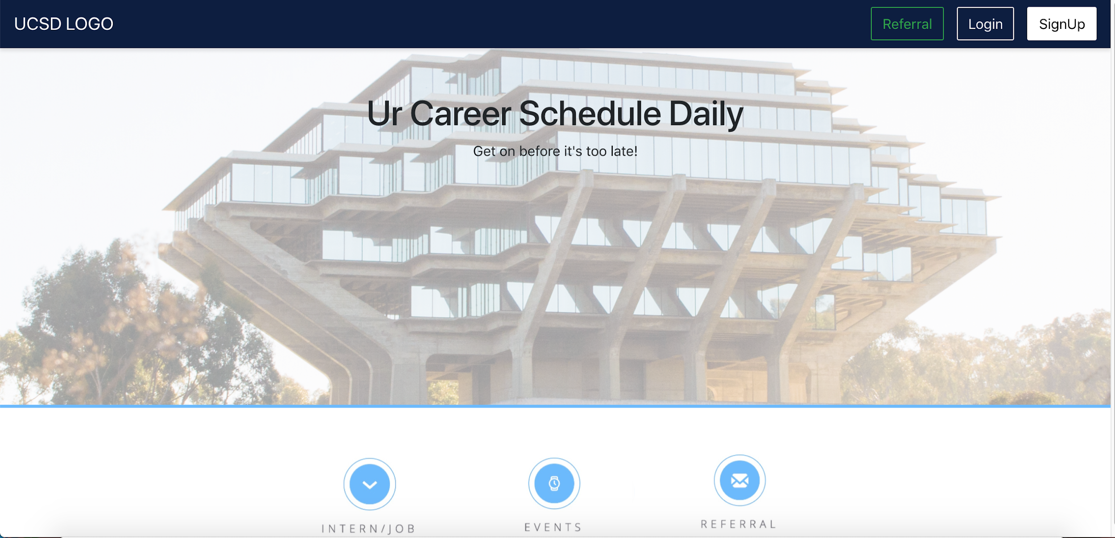
Sample Screen #1: Home Screen

Slide 5
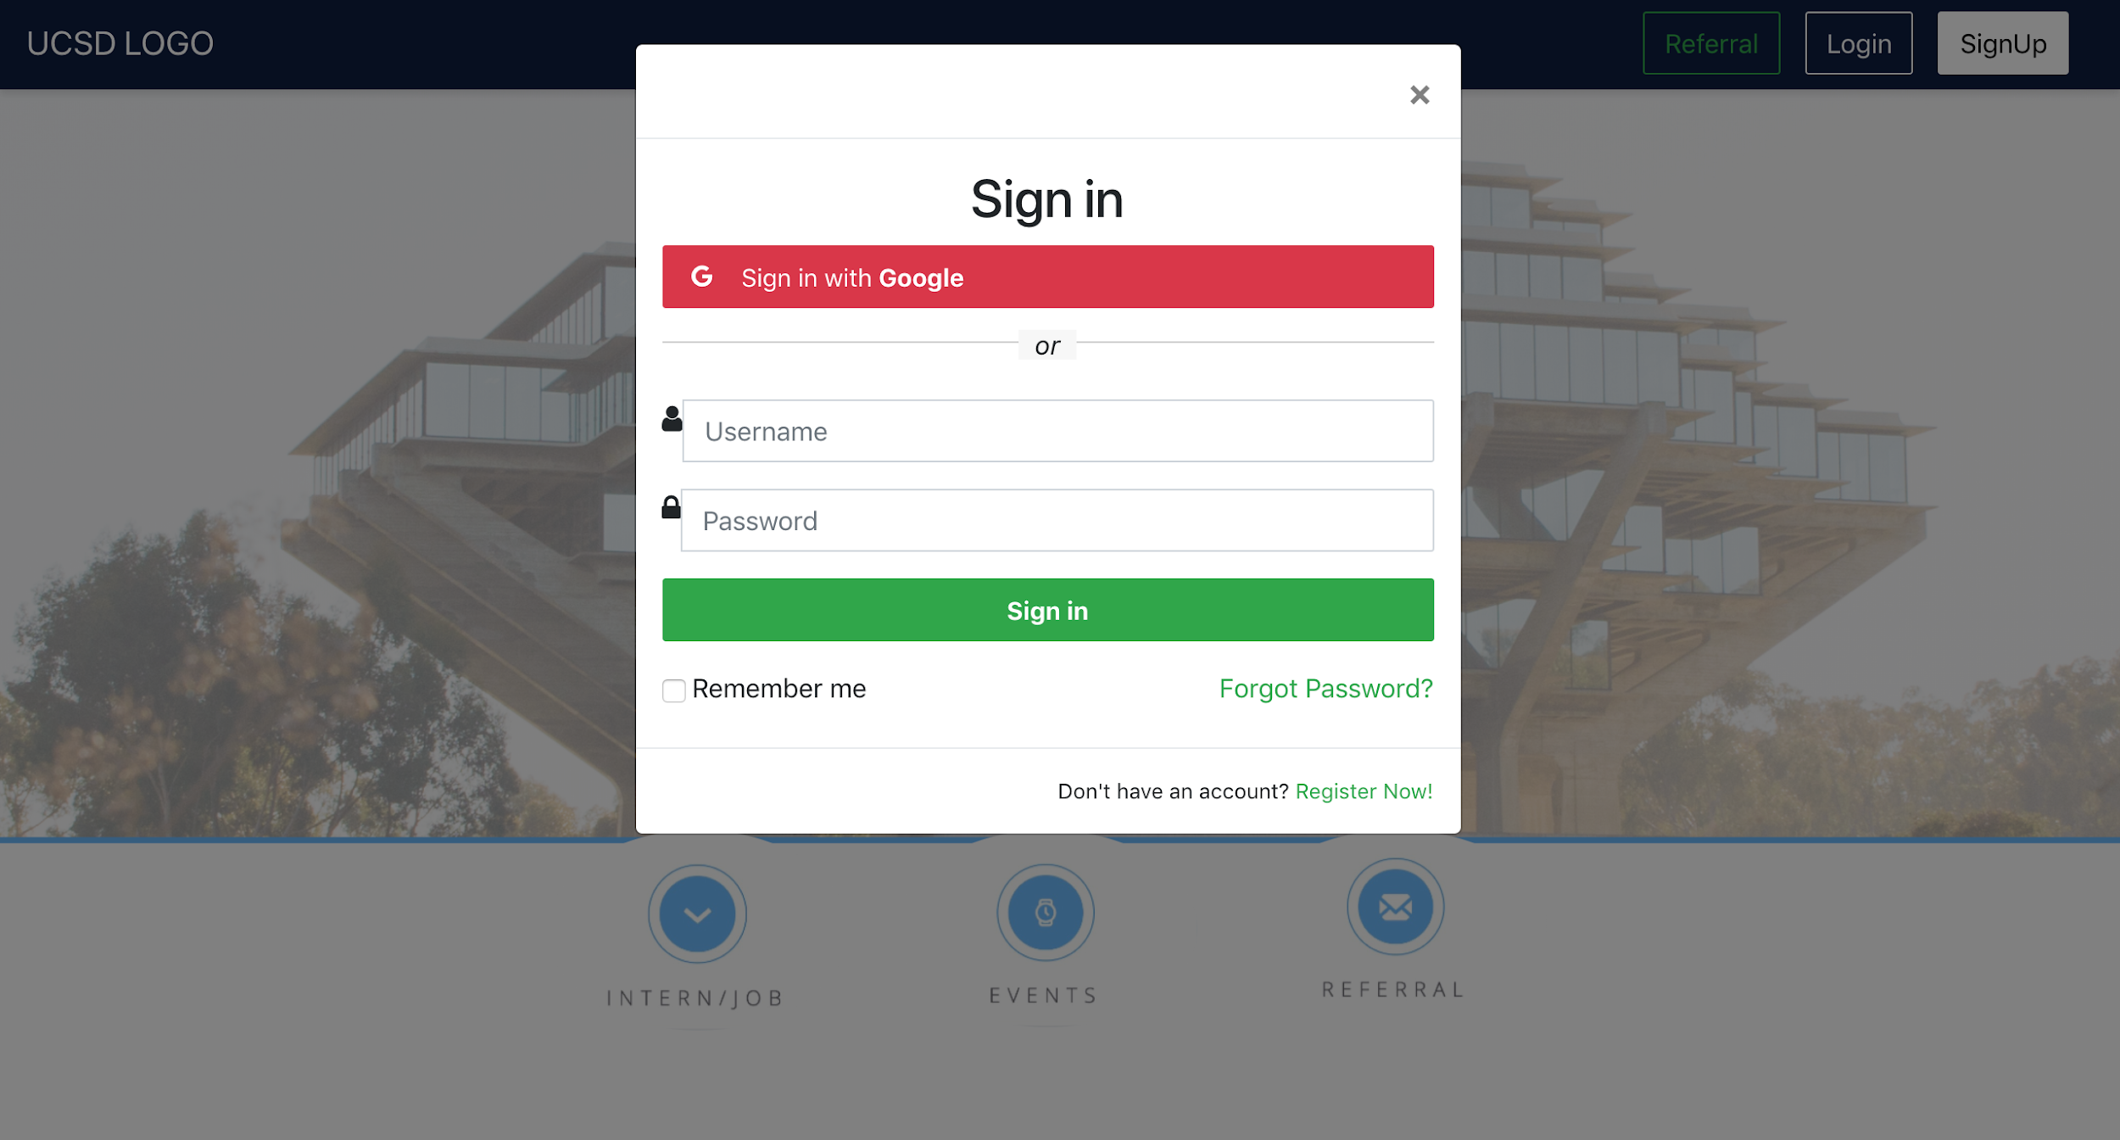
Sample Screen #2: Login Screen

Slide 6
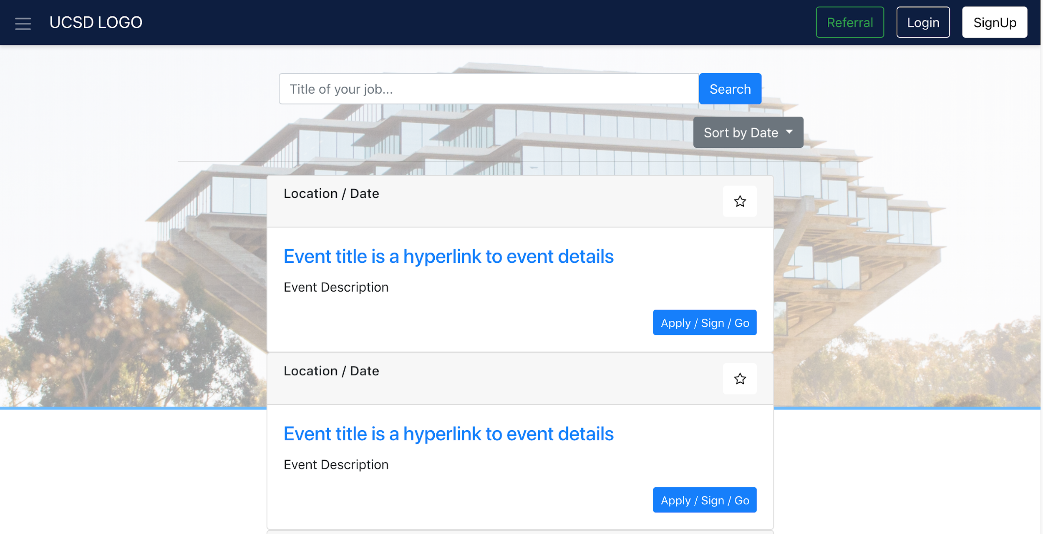
Sample Screen #3: Event Page

Slide 7
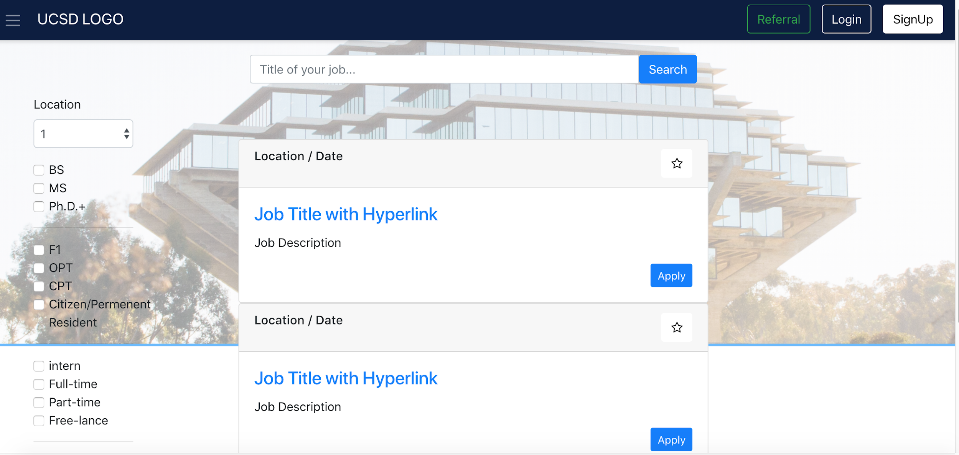
Sample Screen #4: Job Page

Slide 8
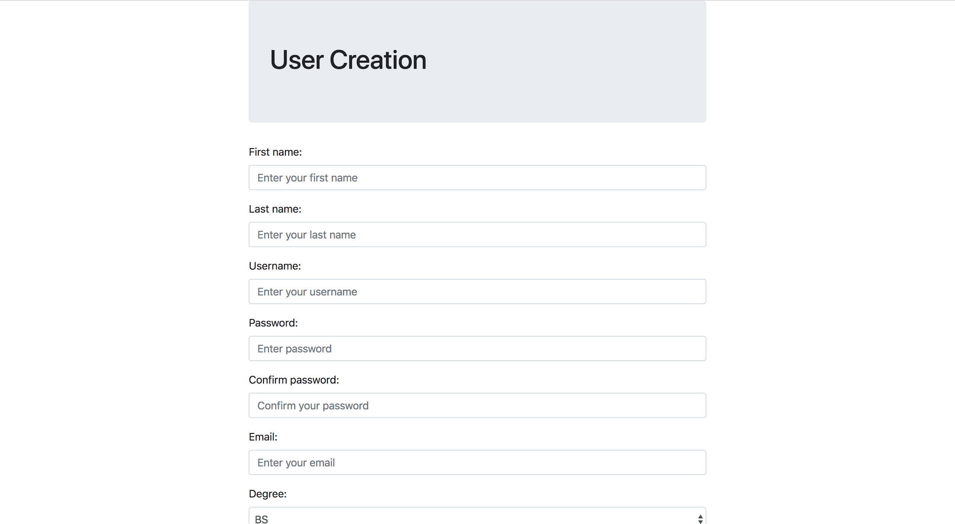

Sample Screen #5: Sign Up Page

Slide 9
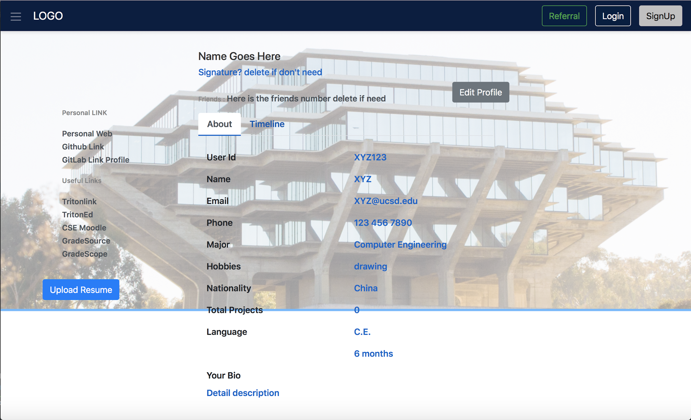
Sample Screen #6: Profile Page

